Slide 1
Problem Statement Worksheet what method for Big Mountain Resort, before the next quarter reduce the 20% cost increase caused by the additional chair, and ensuring the reasonable use of each part of the land, and repositioning the ticket price.
Content
Big Mountain Resort, a ski resort in Montana, provides 350,000 high-quality skiing experiences every year. However, these chair lifts caused unexpected operating costs of up to $1,540,000. The company hopes to cut operating costs by 20% without changing fares. On the contrary, it is necessary to increase the number of votes by 15% based on market average pricing in order to maintain a breakeven.
Criteria for success
Reduce chair lift operating costs by 20% before next quarter.
Scope of solution space
Confirm the rationality of each route based on the scope of the chair lift work. Re-plan the operation plan of the chair lift by analyzing the running time, number of people and income.
Constraints within solution space
If charge a premium that is higher than the average price, it may have an impact on passenger flow.
The existing chair lift configuration may have design flaws
Stakeholders to provide key insight
Jimmy Blackburn(Director of Operations)
Alesha Eisen(Database Manager)
Key data sources
Market average pricing
Financial Statements for the Last Quarter

Slide 2
Key Findings
Current situation
The ticket price of Big Mountain Resort is lower than expected
Expected price is $93.93, actual is $81.00
The features that are most relevant to the ticket price are:
vertical drop, runs, snow making area, fastQuards
For future plan to increase revenue
focus on run, chairs, and vertical drop features that tourists can directly feel
There are opportunities for night skiing

Slide 3
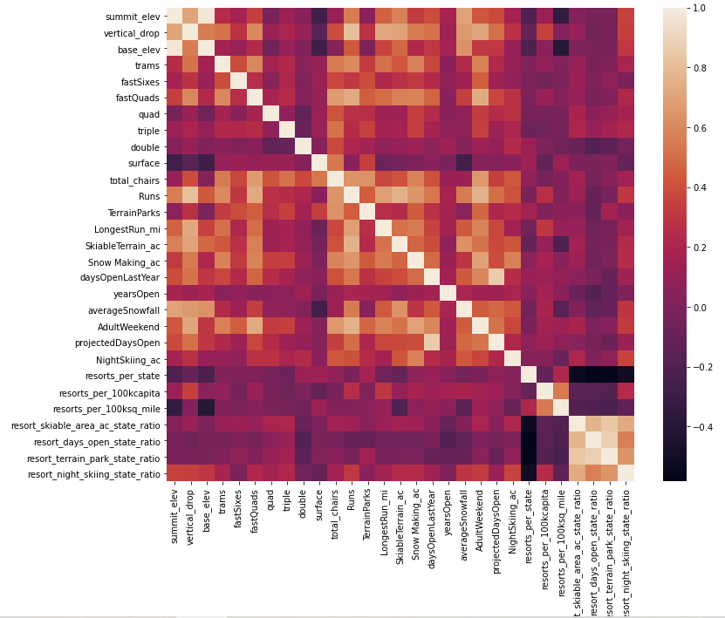
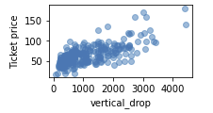
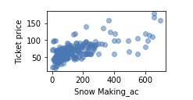
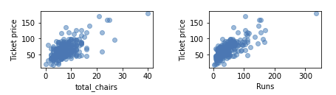
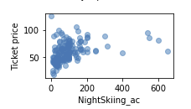
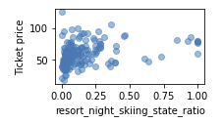
Heat map and Scatter plot
The heat maps indicates the most relevant feature with adultweekend ticket price is vertical drop, fastQuards, runs and snow making area.
Trams, total chairs and DaysOpenLastyear also have high relevance.
In the scatter plot, trams and fastquads didn't appear as linear relationship with ticket price, so they may not use as features for future training model.
The scatter plot of chairs and runs are similarly. They may increase at the same time.
The scatter plot of resort_night_skiing_state_ratio shows posibility of increas ticket price by interest more people at night.
The scatter plot of the vertical decline shows that it is another viable option to increase the ticket price

Slide 4
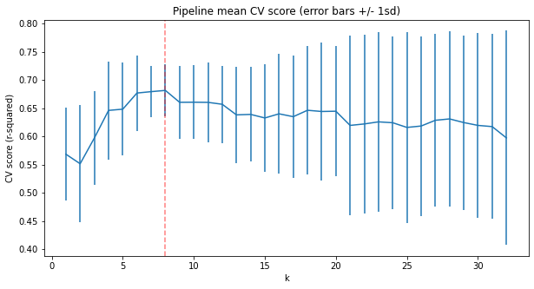
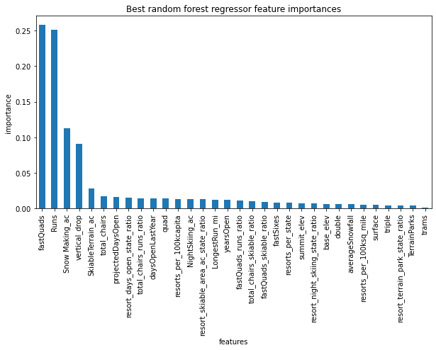
Linear model and random forest model
K = 8
Model score = 0.681
Model score = 0.71

Slide 5
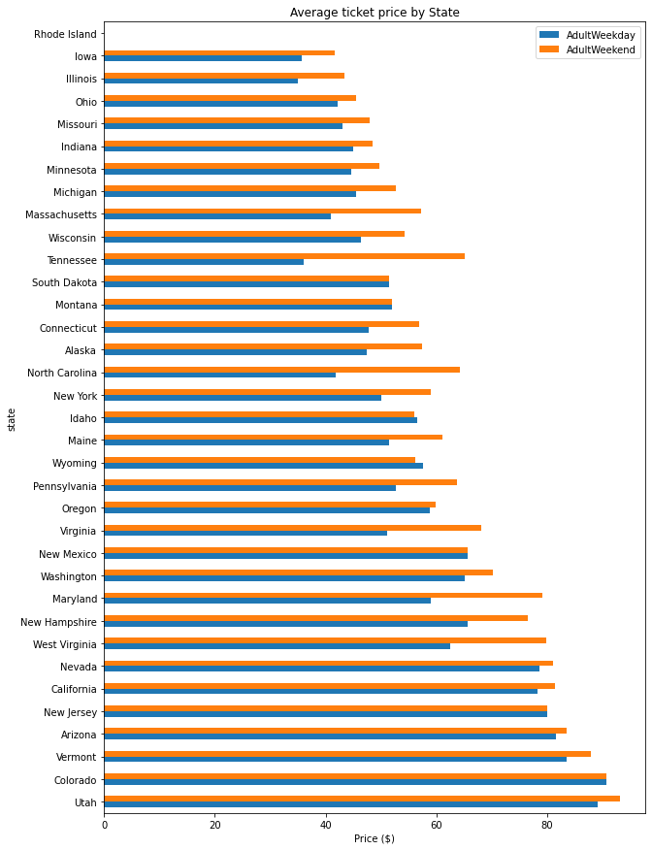
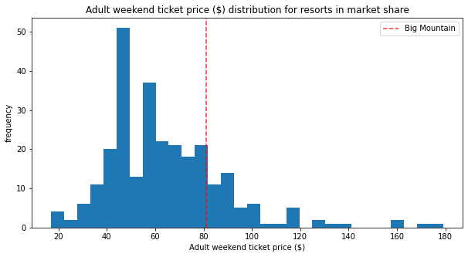
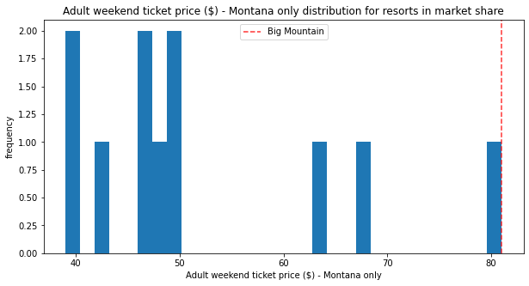
Features distribution in market
The weekend ticket price and weekdays of Montana are same. In other state, the price of weekend are higher than weekdays.
The ticket price of Big Mountain resort in Montana state is at the top level, but in the hole market, it’s only at the middle level.

Slide 6
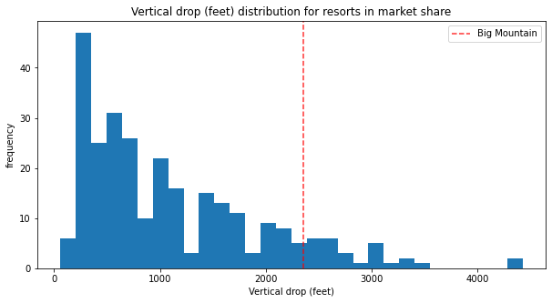
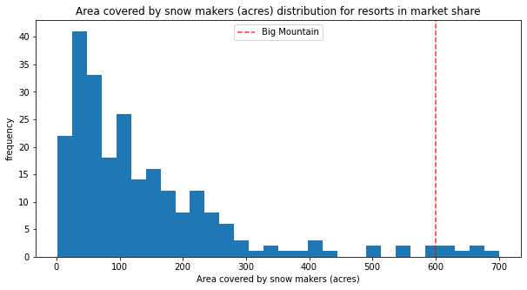
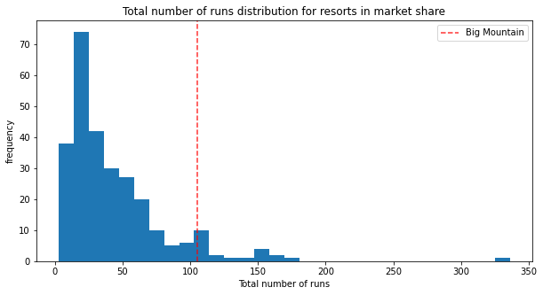
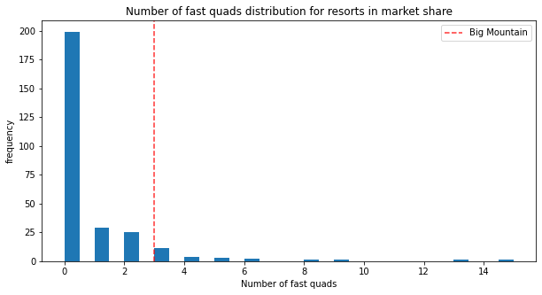
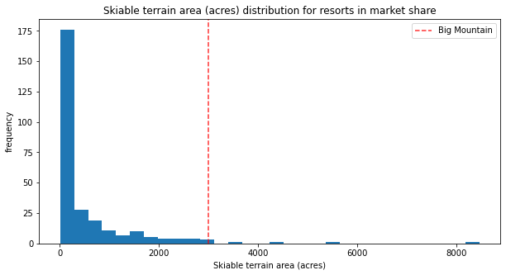
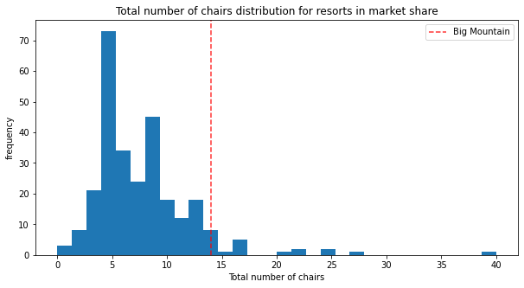
Features distribution in market (2)
Big Mountain Resort's vertical drop, snow making area, total number of chairs, runs, longest run and Skiable terrain area are at a higher level in the same category of market.
The scale of the infrastructure is sufficient to support plans to increase ticket price.

Slide 7
Conclusion
Preliminary plan of control the amount of chairs and runs
1.With only one run reduced, the fare has not changed. Only when four runs were reduced or more, the ticket price dropped significantly.
2. Increase the amount of the run, the height of vertical drop and the number of chairs, the
ticket price will rise($2.07) and get $3622500 per year.
Random forest model can be used as training model but not enough lack of more data :
Annual number of tourists
When the number of tourists reaches the level, the new ticket price of this plan can equalize the operating cost and get more revenue.
Operating cost report
horizontal comparisons with other states. From the result of average ticket price by state, weekend fares in most states are higher than usual, while in Montana
it is almost the same.

